Slide 1
Reducing Paint Related Defects in Pottery Production
Sumeyye Adanur

Slide 2
Business Case
My sister owns a small pottery business. Previously, she purchased pre-mixed pottery paint from suppliers, but the cost was high. To reduce costs, she learned how to create her own paint by mixing pigments and other materials according to recommended ratios.
After using a new paint mixture, she fired 53 pottery pieces in her kiln. Of those 53 pieces, 48 developed paint related defects after firing, resulting in a defect rate of approximately 90.6%. The few pieces that did not develop defects either had no paint applied or only a very small amount of paint.
The high defect rate is creating significant waste, reducing product quality, and increasing production costs. This project will focus on identifying the factors in the paint mixture that contribute to defects and determining the optimal ratio of ingredients to reduce paint related defects and improve overall production yield.
This project is important because defective pottery cannot be sold, resulting in lost revenue, wasted materials, and wasted labor. Every defective piece represents the cost of clay, paint ingredients, kiln usage, and production time without generating income.
DEFINE

Slide 3
Problem & Goal Statement
Y Metric: Paint Related Defect Rate (%)
Problem: The current paint related defect rate in pottery production is approximately 90.6%, with 48 out of 53 pottery pieces exhibiting paint related defects after firing.
Goal: Reduce the paint related defect rate from 90.6% to 1% by end of July, 2026.
DEFINE

Slide 4
Operational Definition
Defects are defined as any fired pottery piece that has one or more paint related defects, including paint chipping, peeling, cracking, bubbling, blistering, discoloration, or poor paint adhesion as measured by inspecting each fired pottery piece after kiln firing and classifying it as either defective or non defective based on the presence of these paint related issues.
MEASURE

Slide 5
Measure - Defect Types (%)
The high defect rate confirms that the current paint process is not capable of consistently producing acceptable products
MEASURE

Slide 6
Measure - Paint Thickness vs Defect Types
This comparation shows defect outcomes across different paint thickness levels
MEASURE

Slide 7
Measure - Paint types vs Defect types
This summarizes defect outcomes for each paint type used
MEASURE

Slide 8
Current State - Sigma Level
Discrete
Total number of units processed | N= | 53
Total number of defects observed | D= | 48
Number of defect opportunities per unit | O= | 1
Defect Per Opportunity | DPO= | 0.9057
Defect Per Million Opportunity | DPMO= | 905,660
Yield rate | yield | 9.4%
Sigma Level | sigma | 1.8
Descriptive Statistics
Total number of units | 53
Total number of defects | 48
Total number of non defects | 5
Defect rate | 90.6%
The current sigma level is quite low. This indicates poor process capability.
MEASURE

Slide 9
Current State- Pottery Process Map
Right Thickness
Start
Mix liquid clay
Pour liquid clay into mold
Wait until desired thickness occurs
Pour out liquid clay to stop drying
no
yes
During sanding pottery broke
Remove pottery from mold
Wait until pottery dries
Sanding pottery
yes
Recycle or Trash
no
no
Pass
Apply paint
Allow paint to dry
Load & Fire kiln:
First fire
Cool
pottery
Apply
Glaze
Load & Fire kiln: Second fire
Cool
pottery
Inspect for paint defects
yes
KEYS
Orange= Value Add
Yellow= No Value Add but Necessary
Green=Decision
Sell Product
MEASURE

Slide 10
Current State- Painting Process Map
Prepare paint
Measure pigment
Measure water
Measure clay
Measure glaze
Measure medium
Mix ingredients
Check consistency
Apply paint
KEYS
Orange= Value Add
Yellow= No Value Add but Necessary
MEASURE

Slide 11
Analysis - Root Cause
The Analyze phase focused on evaluating the paint formulation to identify the cause of the paint related defects because defects increased after switching from commercial paint. Multiple paint formulations were tested by adjusting the grams of pigment, glaze, clay, water. The paint medium was kept constant at 2 drops. Each formulation was applied to five ceramic test tiles and evaluated after firing.
Keeping the firing process consistent;
The kiln setup remained identical for every firing.
The kiln temperature is fixed at 1040 degrees Celsius for all firings.
The kiln reaches 1040°C in 8–10 hours (depending on the outside temperature).
The kiln cools down in around 32–35 hours (depending on the outside temperature).
ANALYZE

Slide 12

Analysis- Fishbone Diagram Analysis
ANALYZE

Slide 13
Analysis- Formulation Trials
Trials | Water (g) | Pigment (g) | Glaze (g) | Glaze* Baume | Clay (g) | Medium Drop* | Total grams | Problem | Total Pottery | Defected Pottery
Original | 11 grams | 6 grams | 10 grams | 37 | 13 grams | 2 drops | 40 grams | Melting, chipping, cracking, discoloration | 53 pieces | 48 pieces
Trial 1 | 11 grams | 6 grams | 10 grams | 36 | 13 grams | 2 drops | 40 grams | Glaze melted | 5 tiles | 5 tiles
Trial 2 | 11 grams | 6 grams | 10 grams | 35 | 13 grams | 2 drops | 40 grams | Glaze melted | 5 tiles | 5 tiles
Trial 3 | 11 grams | 6 grams | 10 grams | 34 | 13 grams | 2 drops | 40 grams | Paint cracking , glaze melted | 5 tiles | 5 tiles
Trial 4 | 11 grams | 8 grams | 10 grams | 34 | 13 grams | 2 drops | 42 grams | Paint pealing, light color, glaze melted | 5 tiles | 5 tiles
Trial 5 | 11 grams | 10 grams | 10 grams | 34 | 13 grams | 2 drops | 44 grams | Discoloration on paint, good color | 5 tiles | 5 tiles
Trial 6 | 11 grams | 12 grams | 10 grams | 34 | 13 grams | 2 drops | 46 grams | Paint chipping, too dark color, glaze melted | 5 tiles | 5 tiles
Trial 7 | 11 grams | 10 grams | 10 grams | 34 | 12 grams | 2 drops | 43 grams | Thick paint, glaze melted | 5 tiles | 5 tiles
Trial 8 | 12 grams | 10 grams | 10 grams | 34 | 12 grams | 2 drops | 44 grams | Watery paint, discoloration on paint | 5 tiles | 5 tiles
Trial 9 | 11 grams | 10 grams | 10 grams | 34 | 11 grams | 2 drops | 42 grams | Good color, discoloration on paint | 5 tiles | 5 tiles
Trial 10 | 11 grams | 10 grams | 10 grams | 34 | 10 grams | 2 drops | 41 grams | None | 5 tiles | 0 tiles
*Medium was held constant at 2 drops for all formulations to provide smooth brush application. The paint medium was not included in the gram batch weight.
*Glaze Baumé is not included in the ratio, but maintaining the correct Baumé level is crucial for a good glaze combination.
ANALYZE

Slide 14
Analysis - Findings
Ingredient | Finding | Impact on Paint Quality
Pigment | 6-8 g provided insufficient coverage; 12 g was excessive; 10 g performed best. | Pigment concentration affected paint coverage and defect formation.
Glaze | Baume 37 was to concentrated; Baum 34 produced the best results. | Proper glaze concentration improved paint stability after firing.
Clay | 13 g produced a thick cloudy result; 10 g provided a smoother consistency. | Excess clay negatively affected paint consistency and finish.
Water | 12 g made the paint thin, watery; 11 g provided good workability. | Water content influenced paint application and consistency.
Paint Medium | Held constant at 2 drops in all trials.(recommended amount) | Controlled variable: improved paint workability and was not investigated as a cause.
ANALYZE

Slide 15
Analysis - Summary
Ingredient ratios significantly influenced paint performance after firing.
The original recommended formulation did not produce a stable paint mixture for this production process.
Testing identified the standard ratios for pigment, glaze, clay, and water, which were used to develop an improved formula.
Additional testing showed that multilayer applications required a thinner paint consistency to prevent defects.
ANALYZE

Slide 16
Improve – Optimized Formula Validation
Test | Formula Used | Total number of pieces | Single layer painting | Multilayer painting | Total number of defected pieces | Result
Production firing #1 | Trial 10 formula (best formula) | 32 | 29 | 3 | 3 | Standard single layer painting successful; defects remained in multilayer applications
Production firing #2 | -Trial 10 formula for single layer -Trial 10 formula + 1g more water for multilayer | 37 | 30 | 6 | 1 | Only 1 remaining defect due to painting technique (person)
IMPROVE

Slide 17
Improve – DPMO and Sigma Level
Formula A
Total number of units processed | N= | 32
Total number of defects observed | D= | 3
Number of defect opportunities per unit | O= | 1
Defect Per Opportunity | DPO= | 0.09375
Defect Per Million Opportunity | DPMO= | 93,750
Yield rate | yield | 90.625%
Sigma Level | sigma | 2.8
Formula B
Total number of units processed | N= | 37
Total number of defects observed | D= | 1
Number of defect opportunities per unit | O= | 1
Defect Per Opportunity | DPO= | 0.02703
Defect Per Million Opportunity | DPMO= | 27,027
Yield rate | yield | 97.30%
Sigma Level | sigma | 3.4
Formula A Defect Rate = 3/32=0.09375= 9.38%
Formula B Defect Rate= 1/37=0.02703= 2.70%
IMPROVE

Slide 18
Improve
We implemented the trial 10 formulation using the identified ingredient ratios.
We developed a second formulation with increased water content for multilayer paint applications.
We validated the new formulations through additional kiln firings.
The defect rate decreased from 90.6% (48 defects in 55 pieces) to 2.7% (1 defect in 37 pieces). Yield improved from 9.4% to 97.3%, demonstrating that the process changes were effective in reducing defects.
IMPROVE

Slide 19
Improve - Standardized Formula
Application Type | Formula | Water (g) | Pigment (g) | Glaze (g) | Glaze Baume | Clay (g) | Medium drop
Single layer painting | Formula A | 11 grams | 10 grams | 10 grams | 34 | 10 grams | 2 drops
Multilayer painting | Formula B | 12 grams | 10 grams | 10 grams | 34 | 10 grams | 2 drops
Formula A is created for standard single layer painting.
Formula B is created for multilayer painting.
IMPROVE

Slide 20
Improve – Cost Analysis
Paint Type | Cost per 40g Batch
Store bought paint | $8.51
Homemade paint | $2.76
Saving per batch | $5.75
Product | Production cost with homemade paint | Selling price | Estimated Gross Margin
Mug | $2.00 | $18.00 | $16.00
Bowl | $2.00 | $10.00 | $8.00
Plate | $2.26 | $15.00 | $12.74
Product | Production cost with store bought paint | Selling price | Estimated Gross Margin
Mug | $2.19 | $18.00 | $15.81
Bowl | $2.19 | $10.00 | $7.81
Plate | $2.55 | $15.00 | $12.45
IMPROVE

Slide 21
Improve- Cost Analysis Summary
Pottery materials represent a relatively small portion of the final product value. While using homemade paint can reduce material costs significantly, the largest financial impact comes from preventing defects. Each defective product can result in the loss of materials, labor time, kiln usage, and potential sales revenue. Therefore, reducing paint-related defects is more important than only lowering paint costs, because preventing a defective product preserves the full value of the finished piece.
IMPROVE

Slide 22
Recommendations- Control
Control | Purpose
Standard Formula A | Single layer paint applications
Standard Formula B | Multilayer paint applications
Measure ingredients by weight before mixing | Ensure consistency
Use a standardized multilayer application checklist | Minimize painter related defects
Document recipes | Reduce Variation
The project goal was to reduce the paint related defect rate to 1%. This target was selected because once an optimized paint formula is achieved, paint related defects should be minimized, with remaining defects mainly caused by painter related variation. Although the target was not fully archived, the implemented improvements reduced the defect rate from 90.6% in the original process to 2.7% after applying the Formula B.
RECOMMENDATIOS

Slide 23
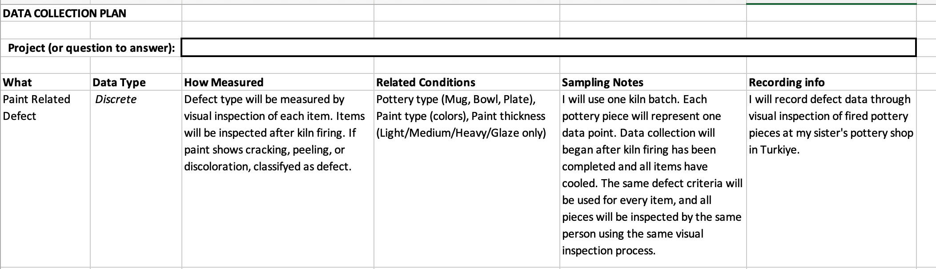
Appendix A: Data Collection Plane
DATA COLLECTIONS

Slide 24
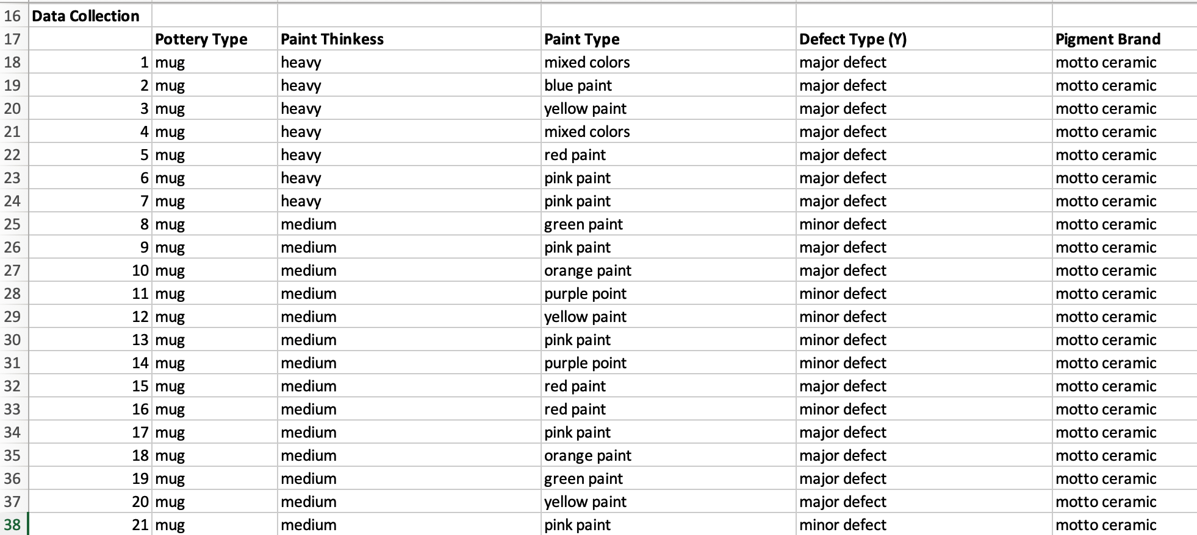
Appendix B: Data Collection
DATA COLLECTIONS

Slide 25
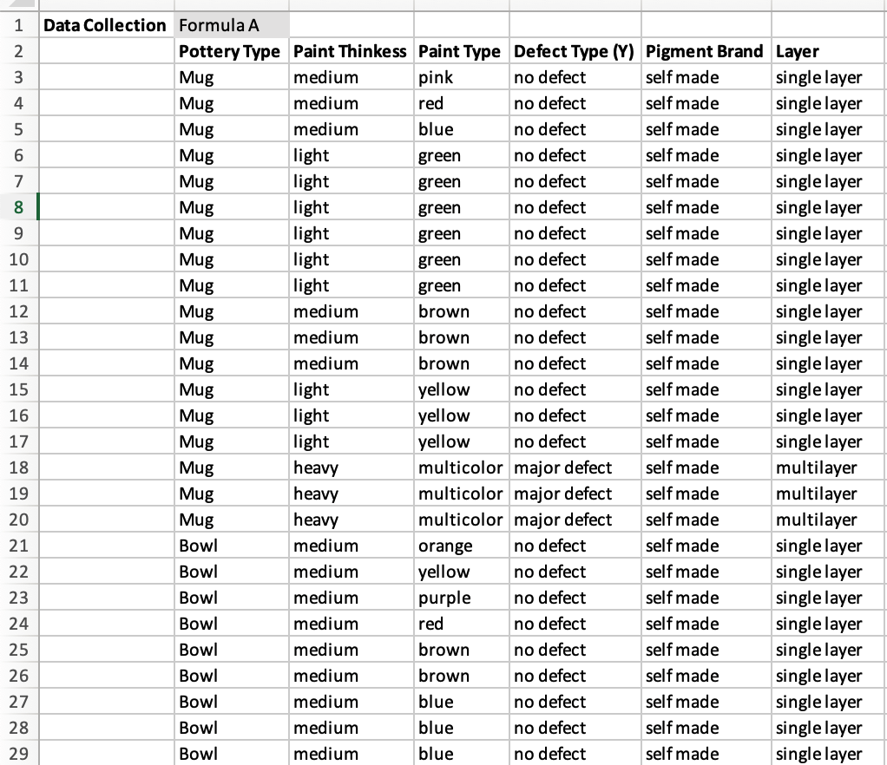
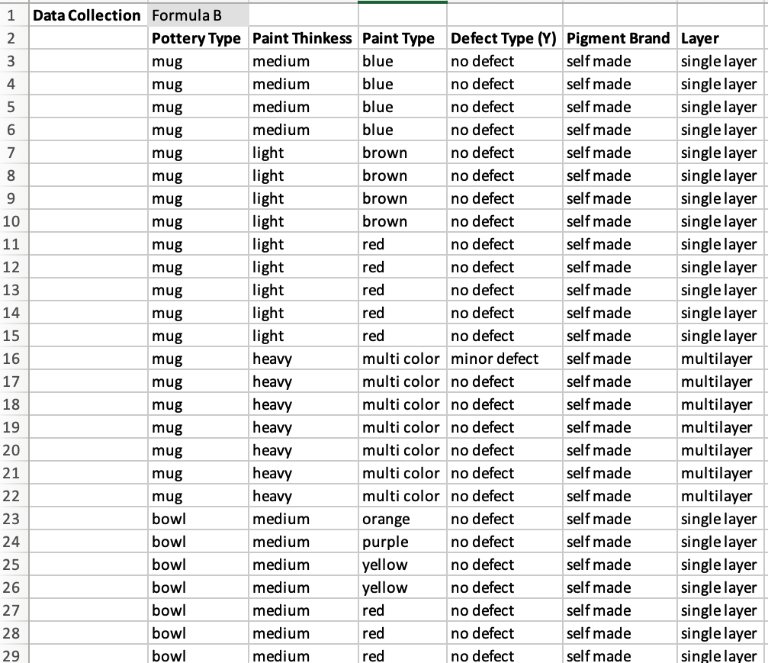
Appendix C: Data Collection

